Slide 1

Software Design and Arcitecture(SDA) Lecture 13
Engr.Ramsha Mashood
Senior Lecturer
Department of Software Engineering
Bahria University Karachi Campus

Slide 2



Quality tactics

Slide 3

Software quality tactics

Slide 4
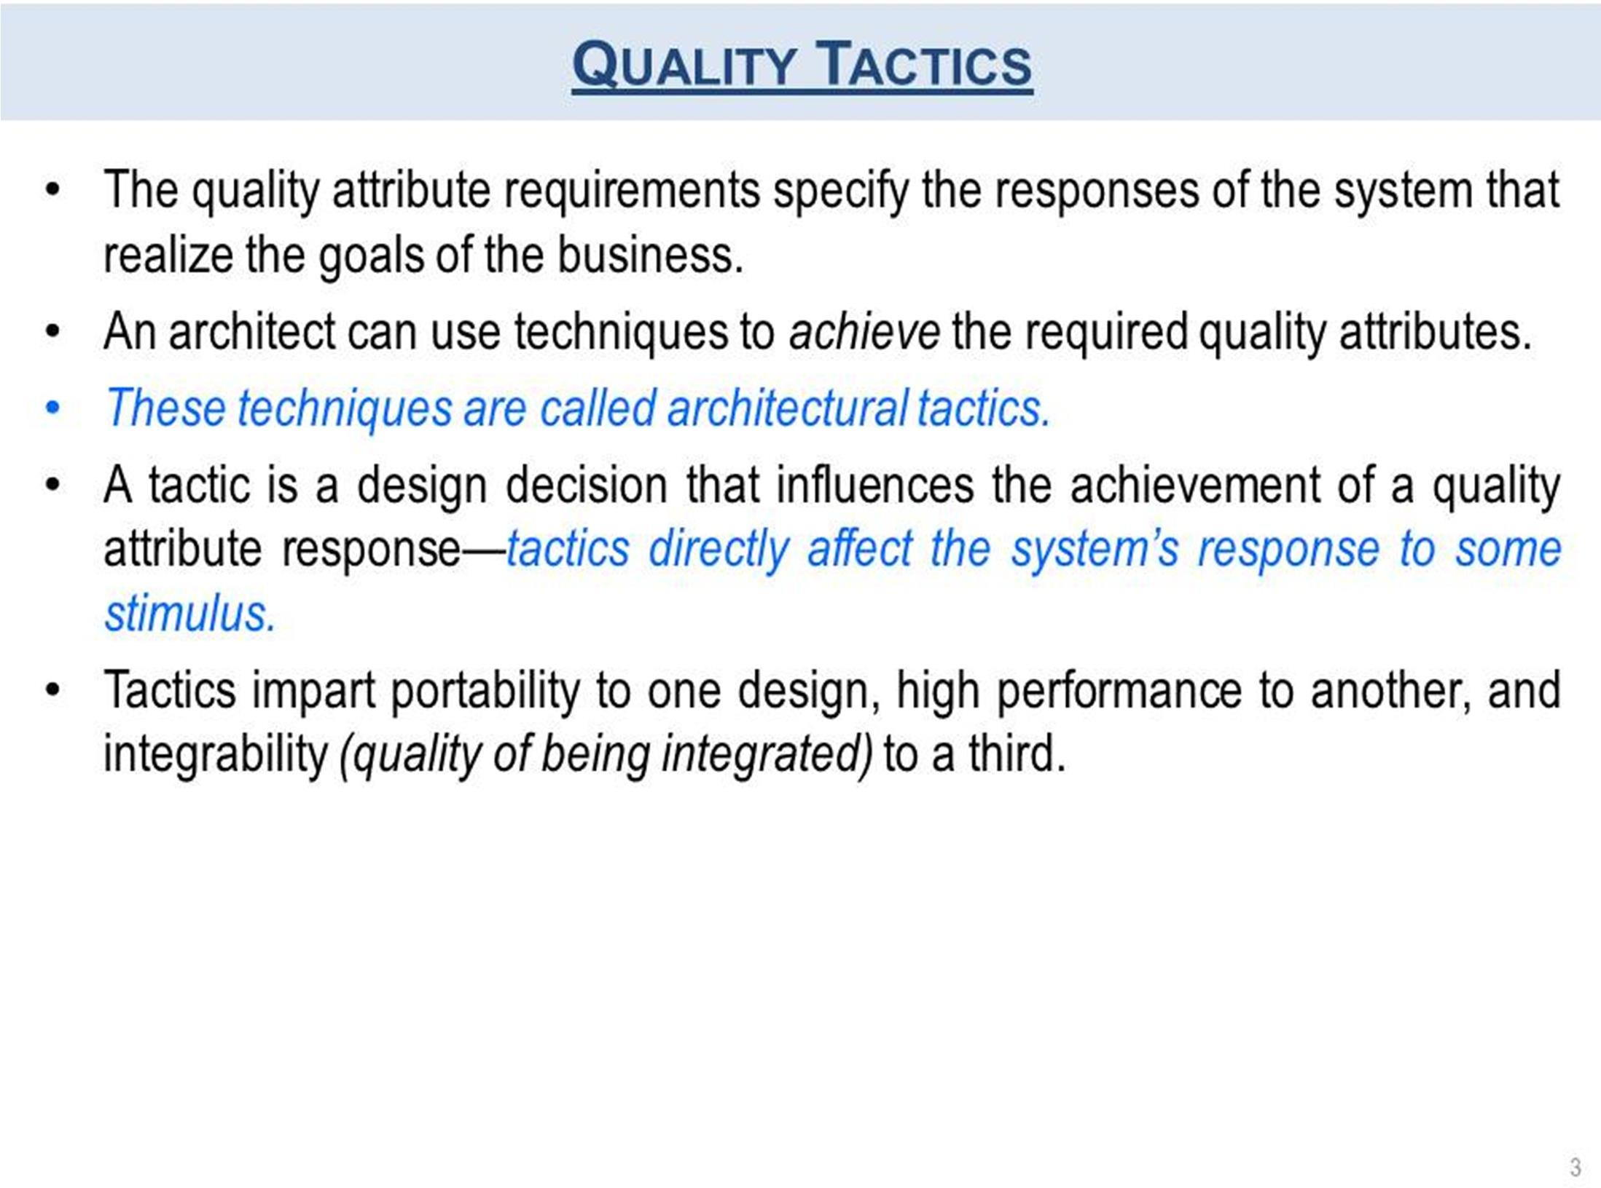
QUALITY TACTICS

Slide 5
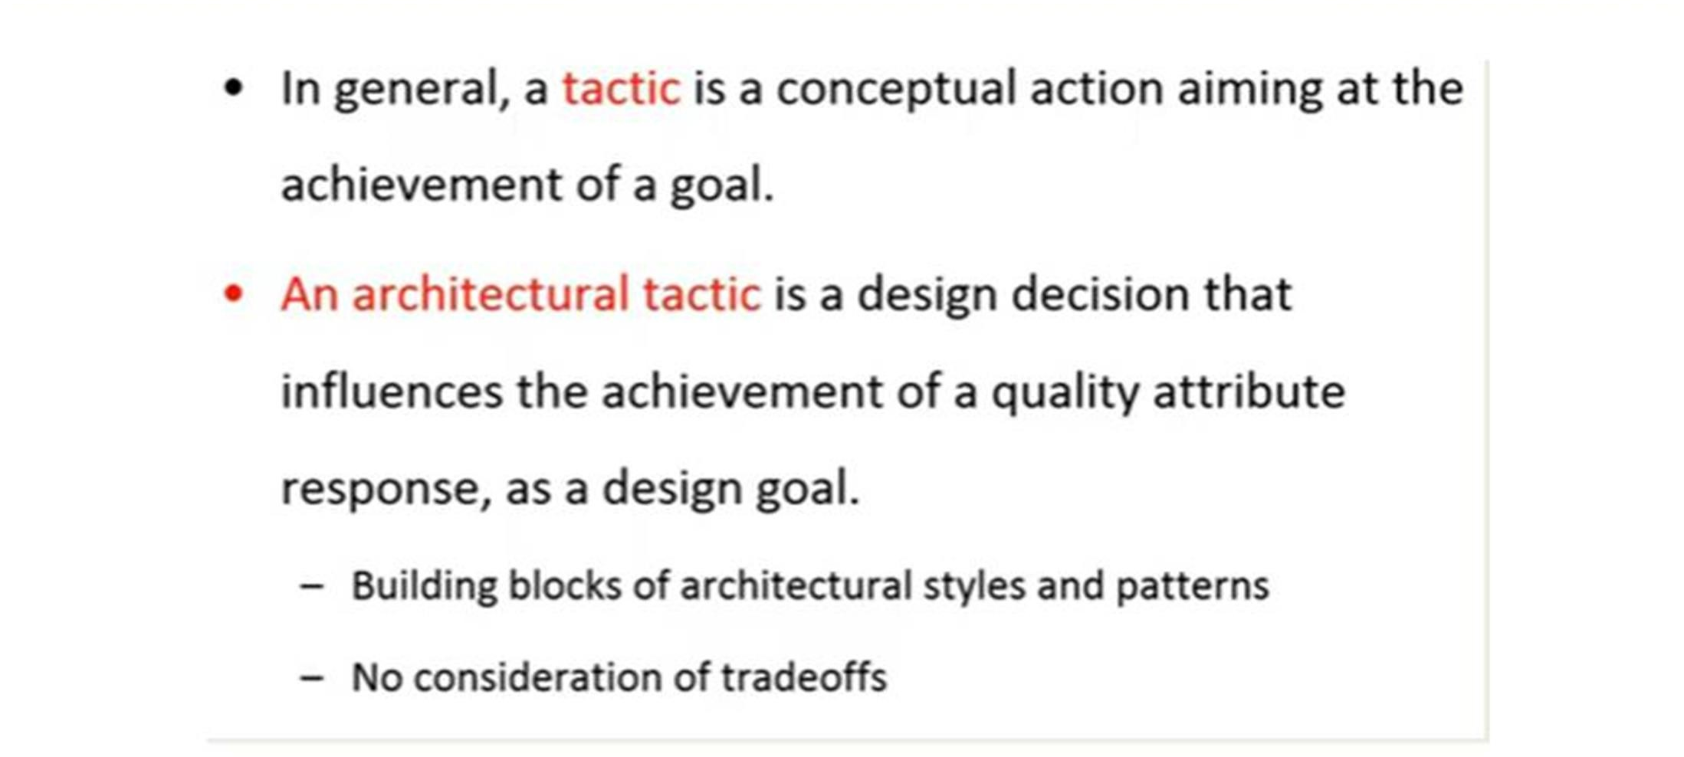
QUALITY TACTICS

Slide 6
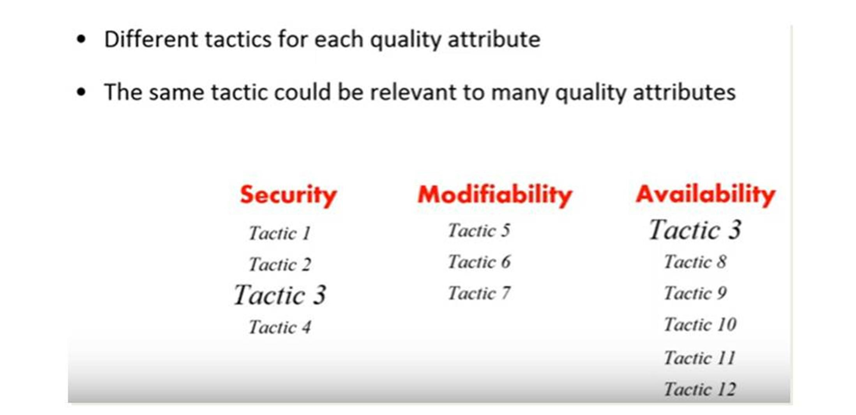
QUALITY TACTICS

Slide 7
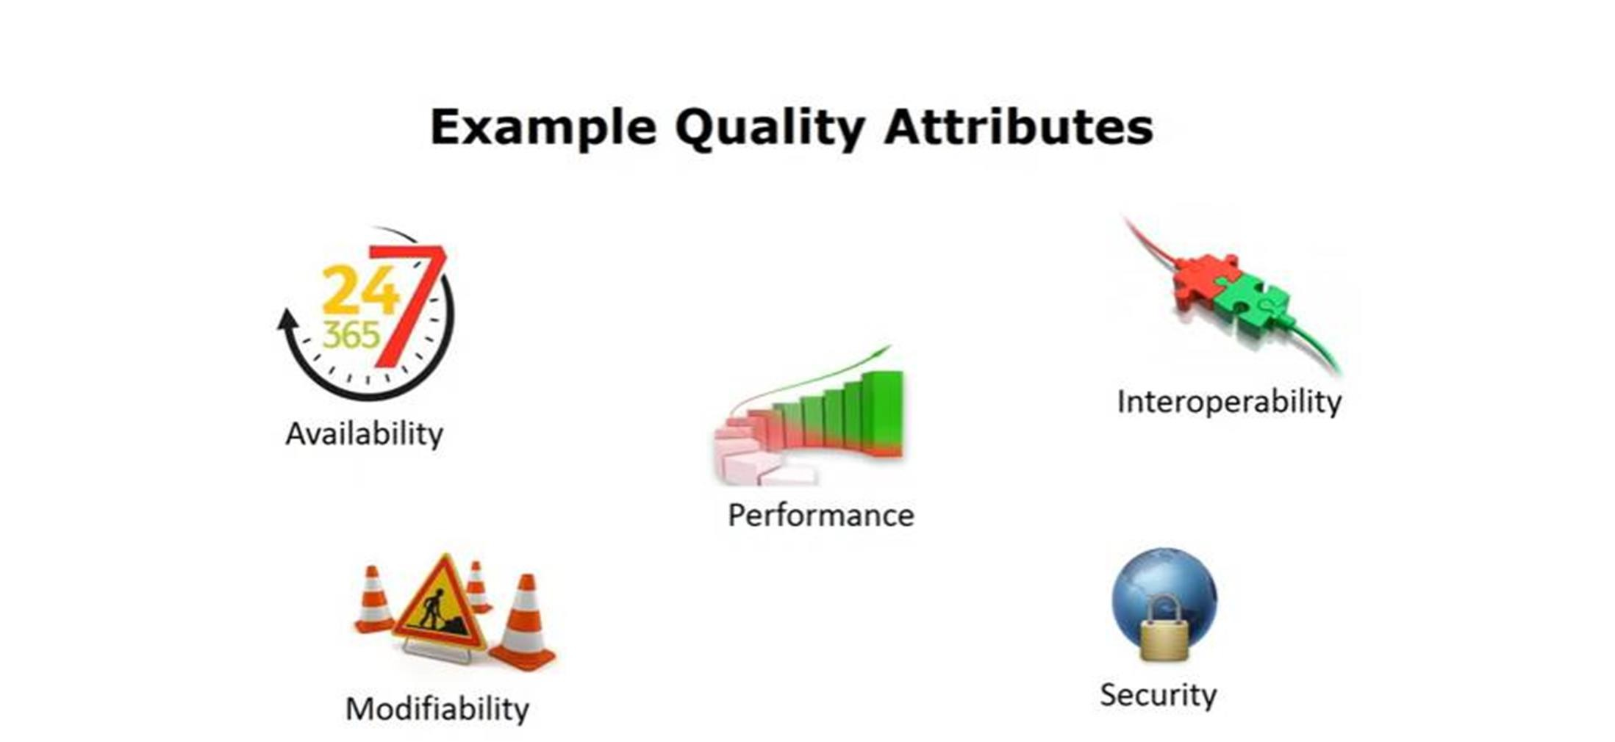
EXAMPLE QUALITY TACTICS

Slide 8
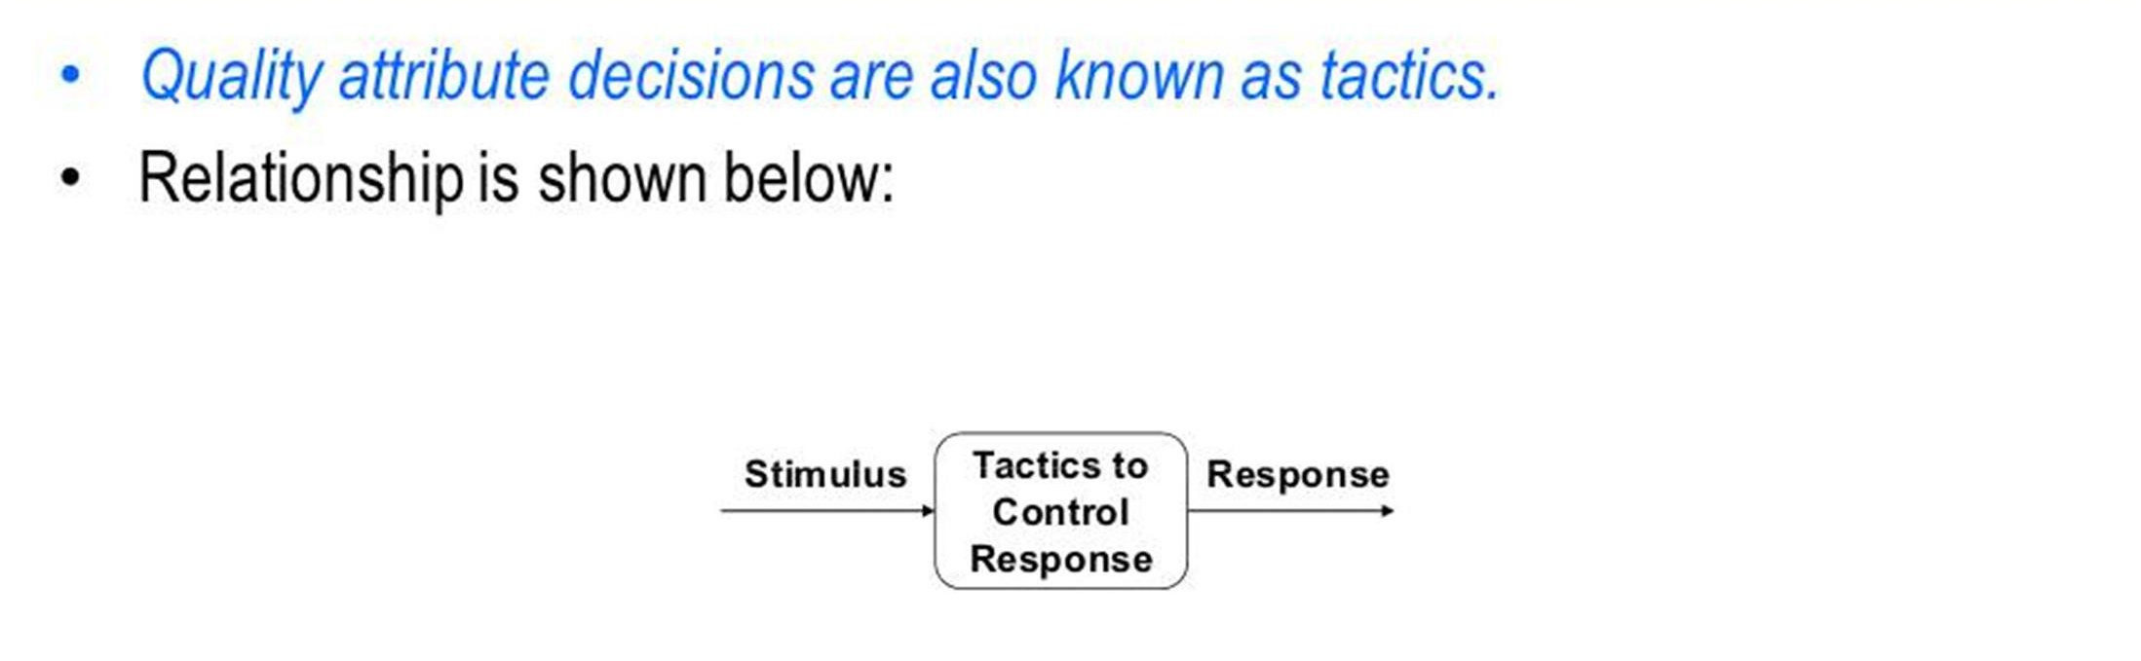
QUALITY TACTICS

Slide 9
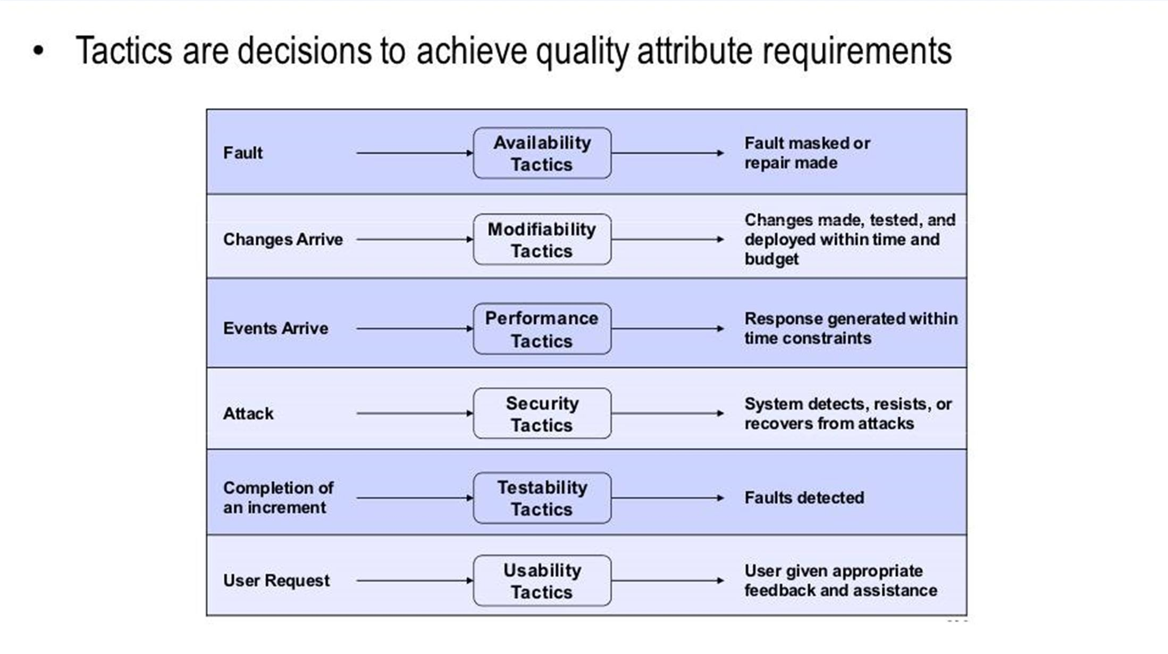
QUALITY TACTICS

Slide 10

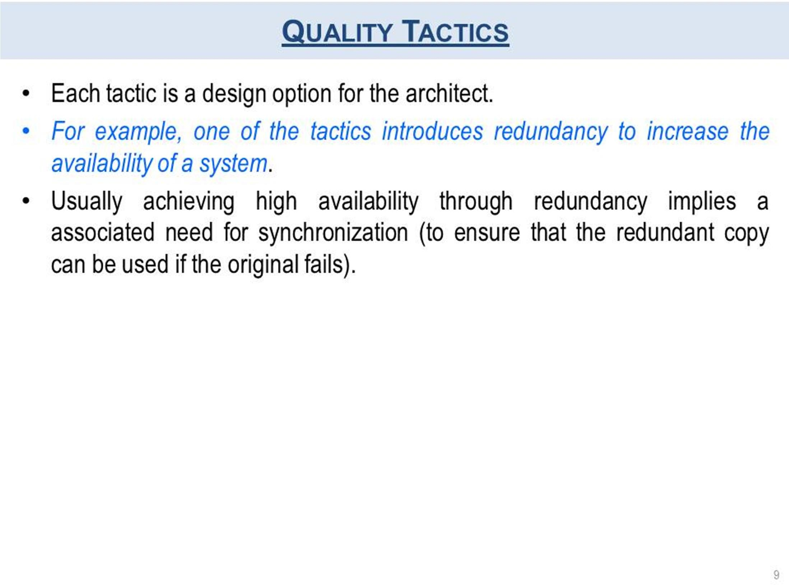

Slide 11
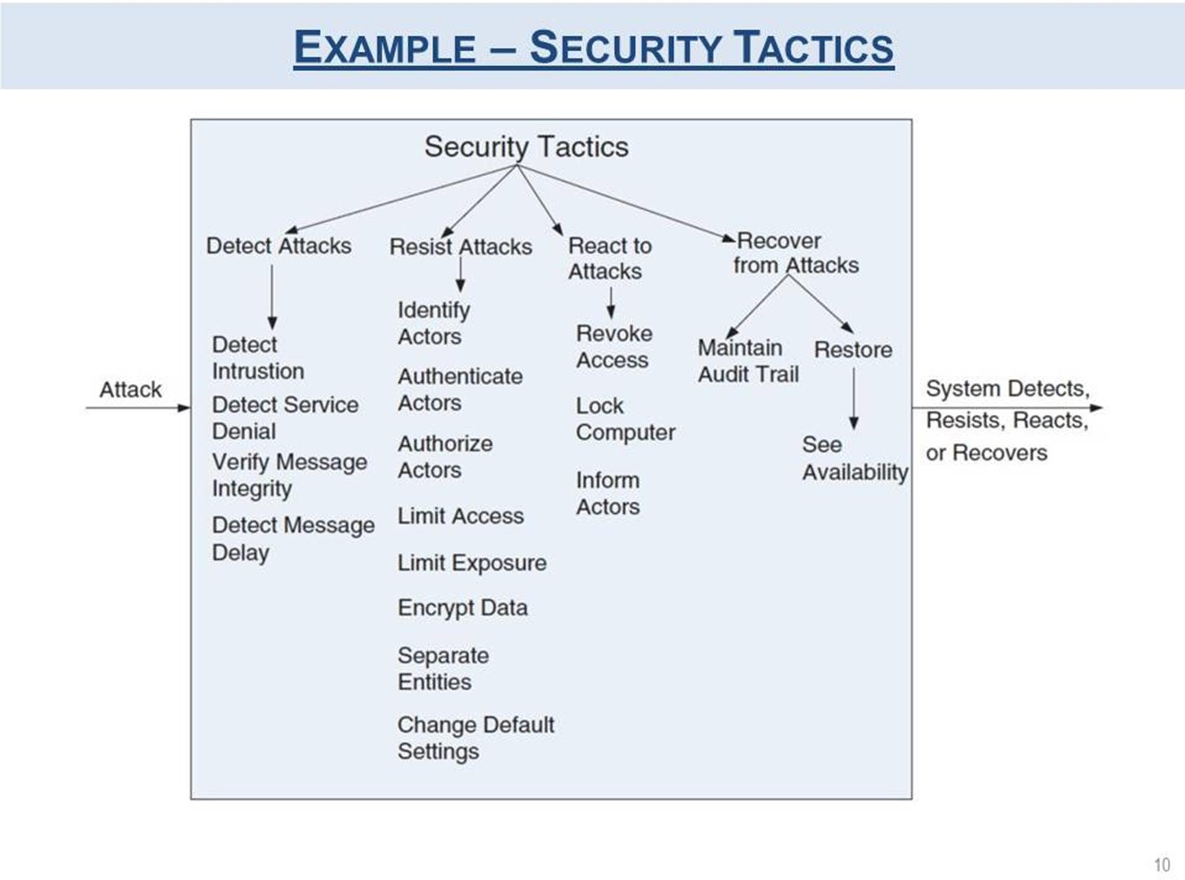

Slide 12
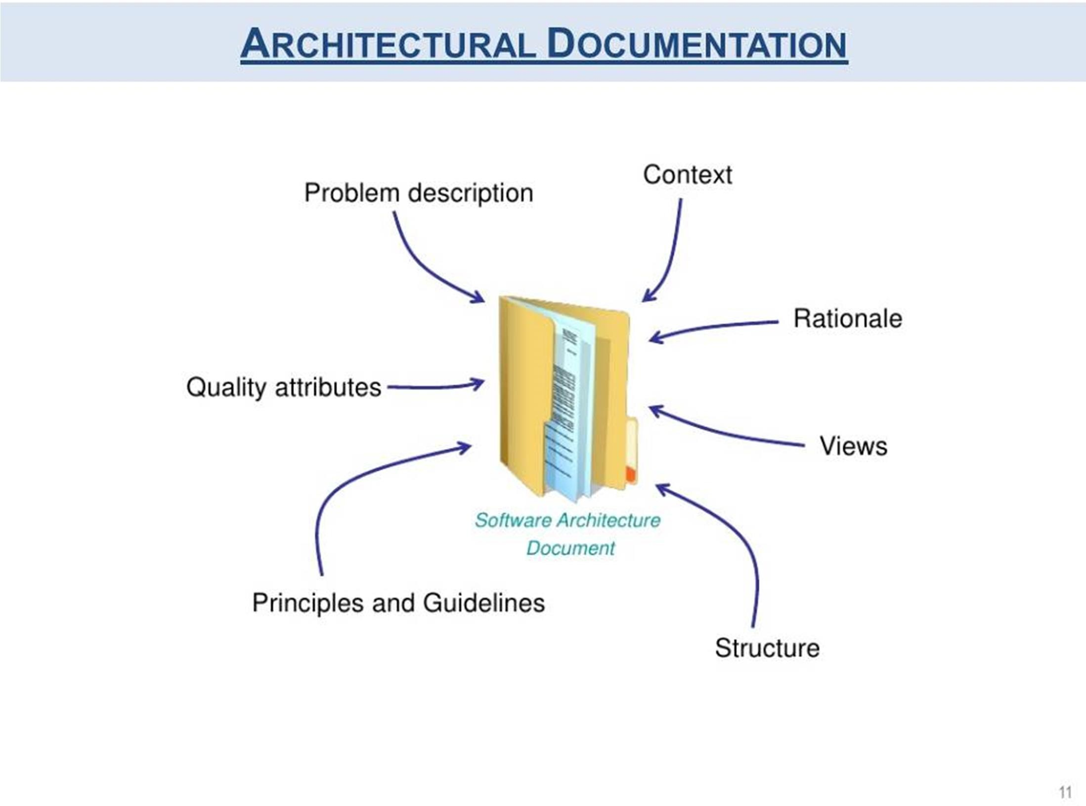

Slide 13
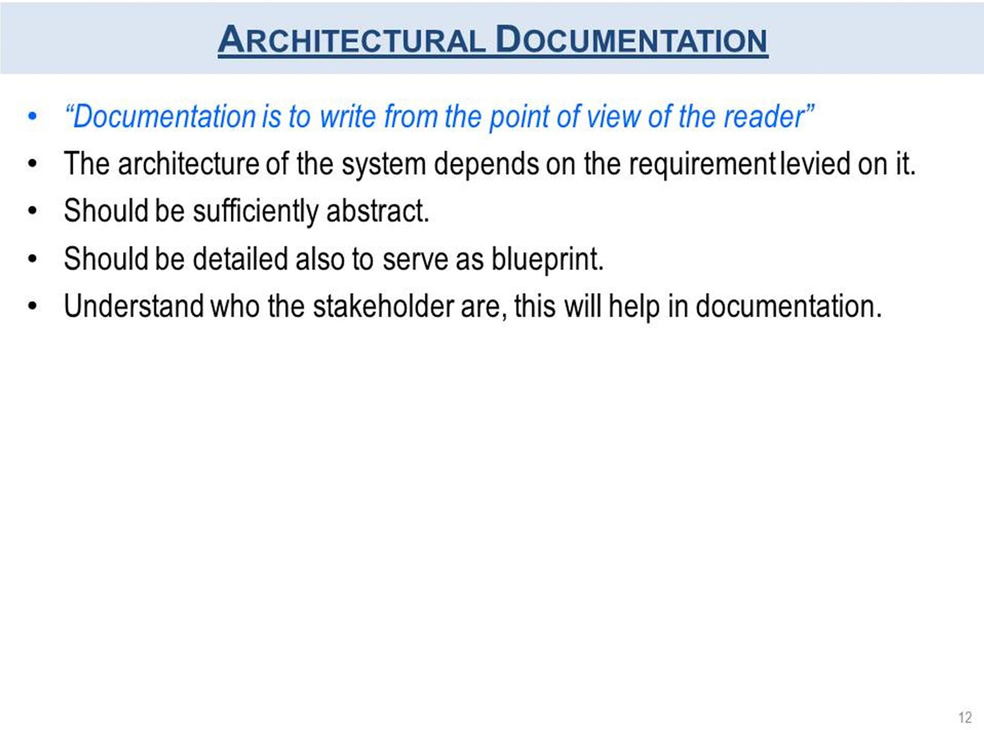

Slide 14
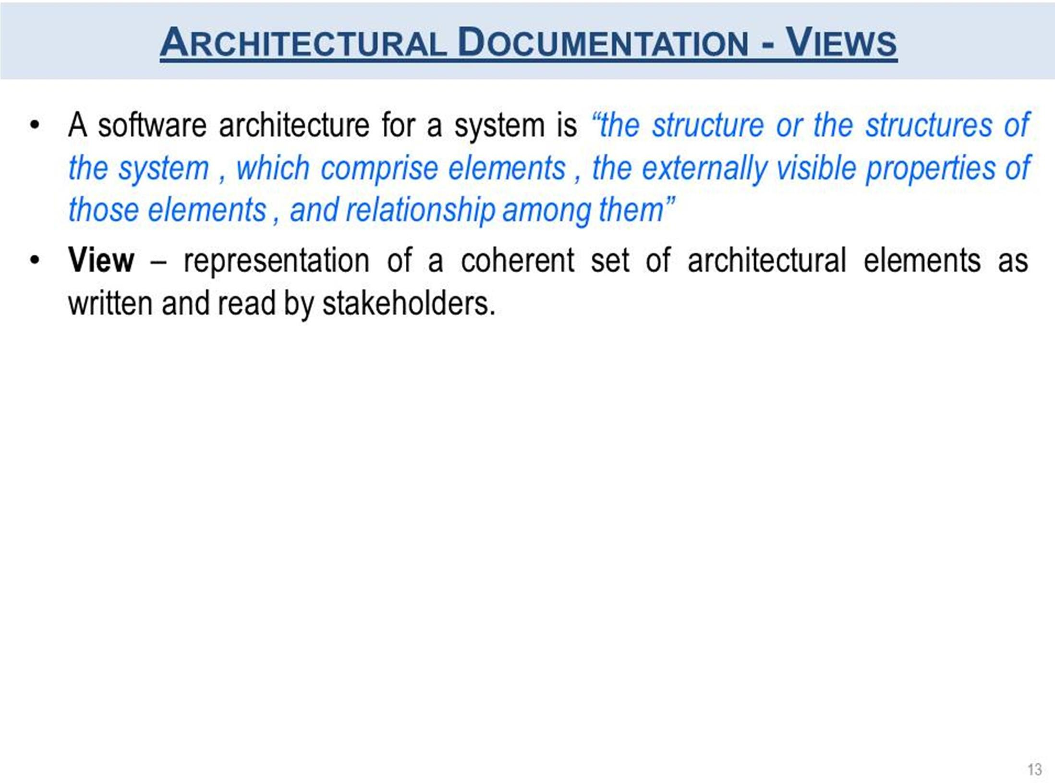

Slide 15
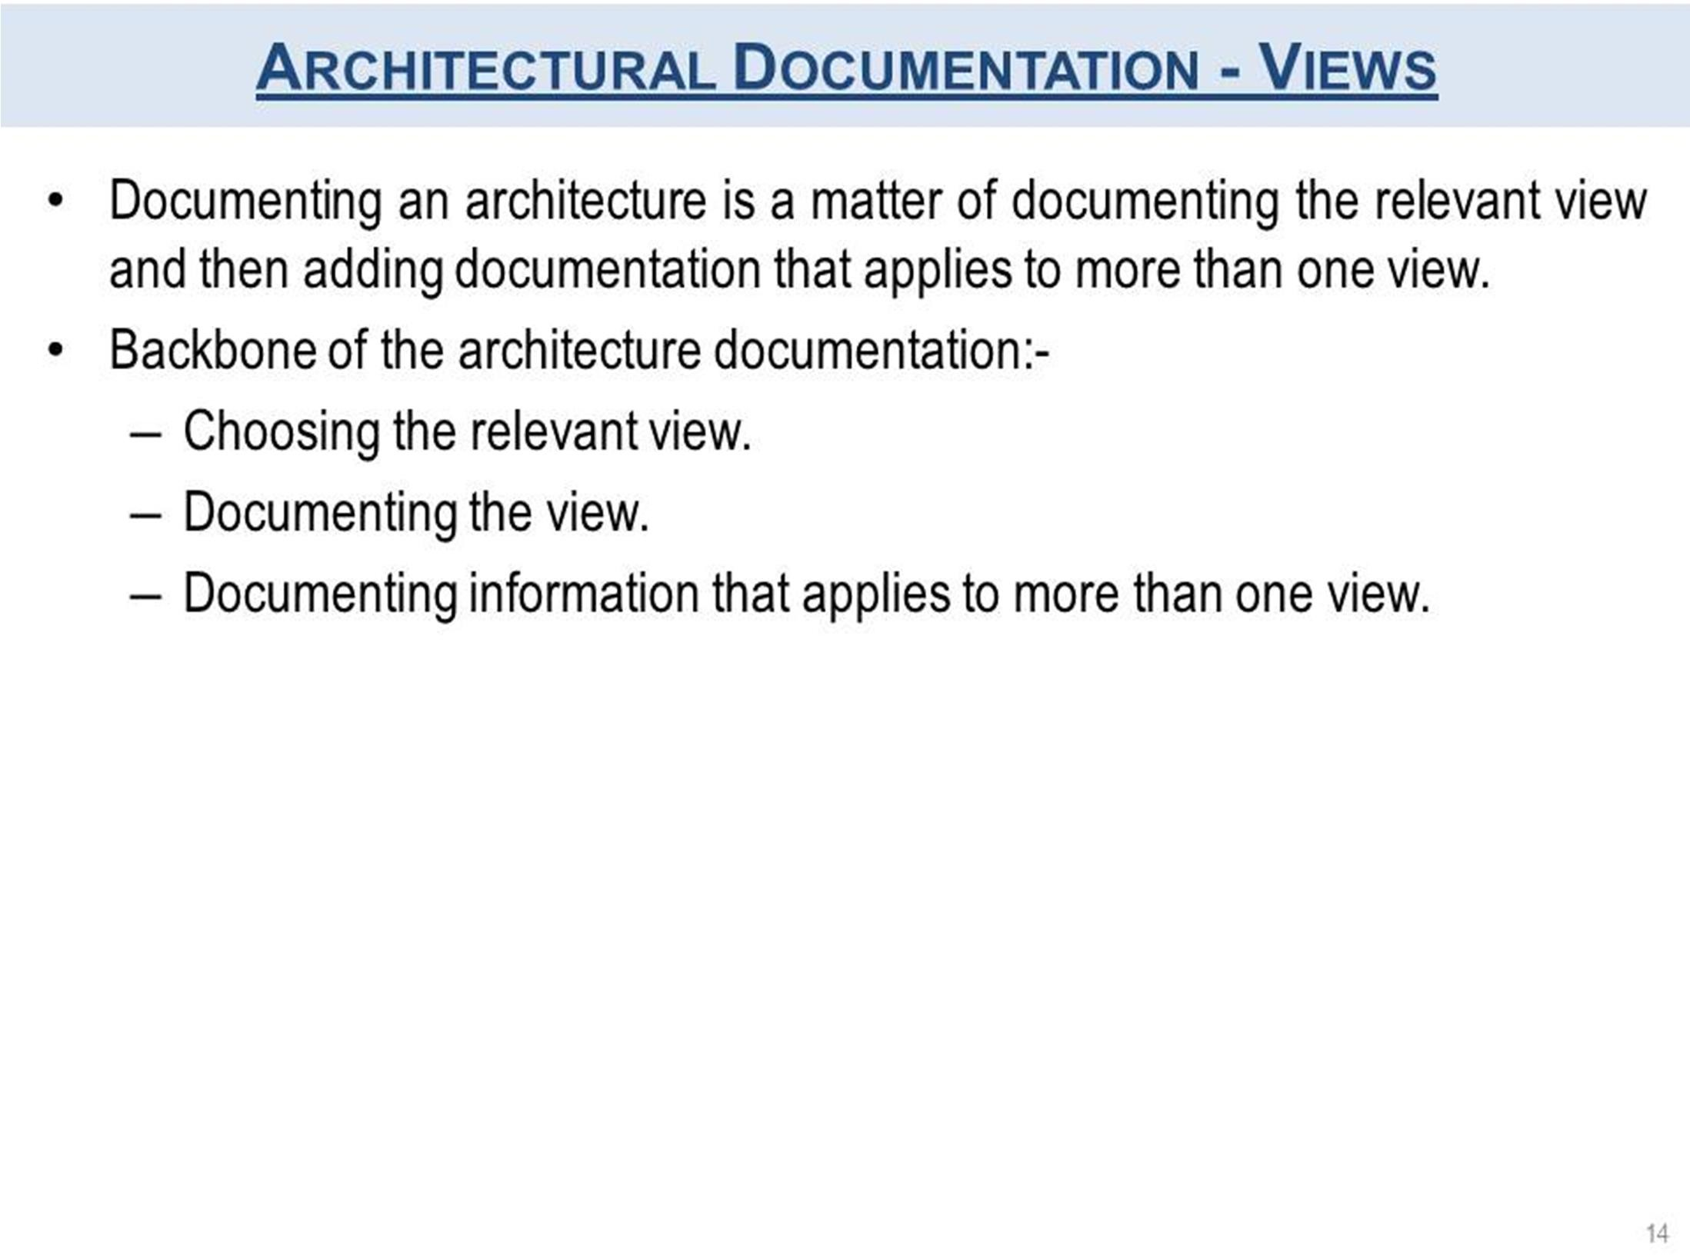

Slide 16
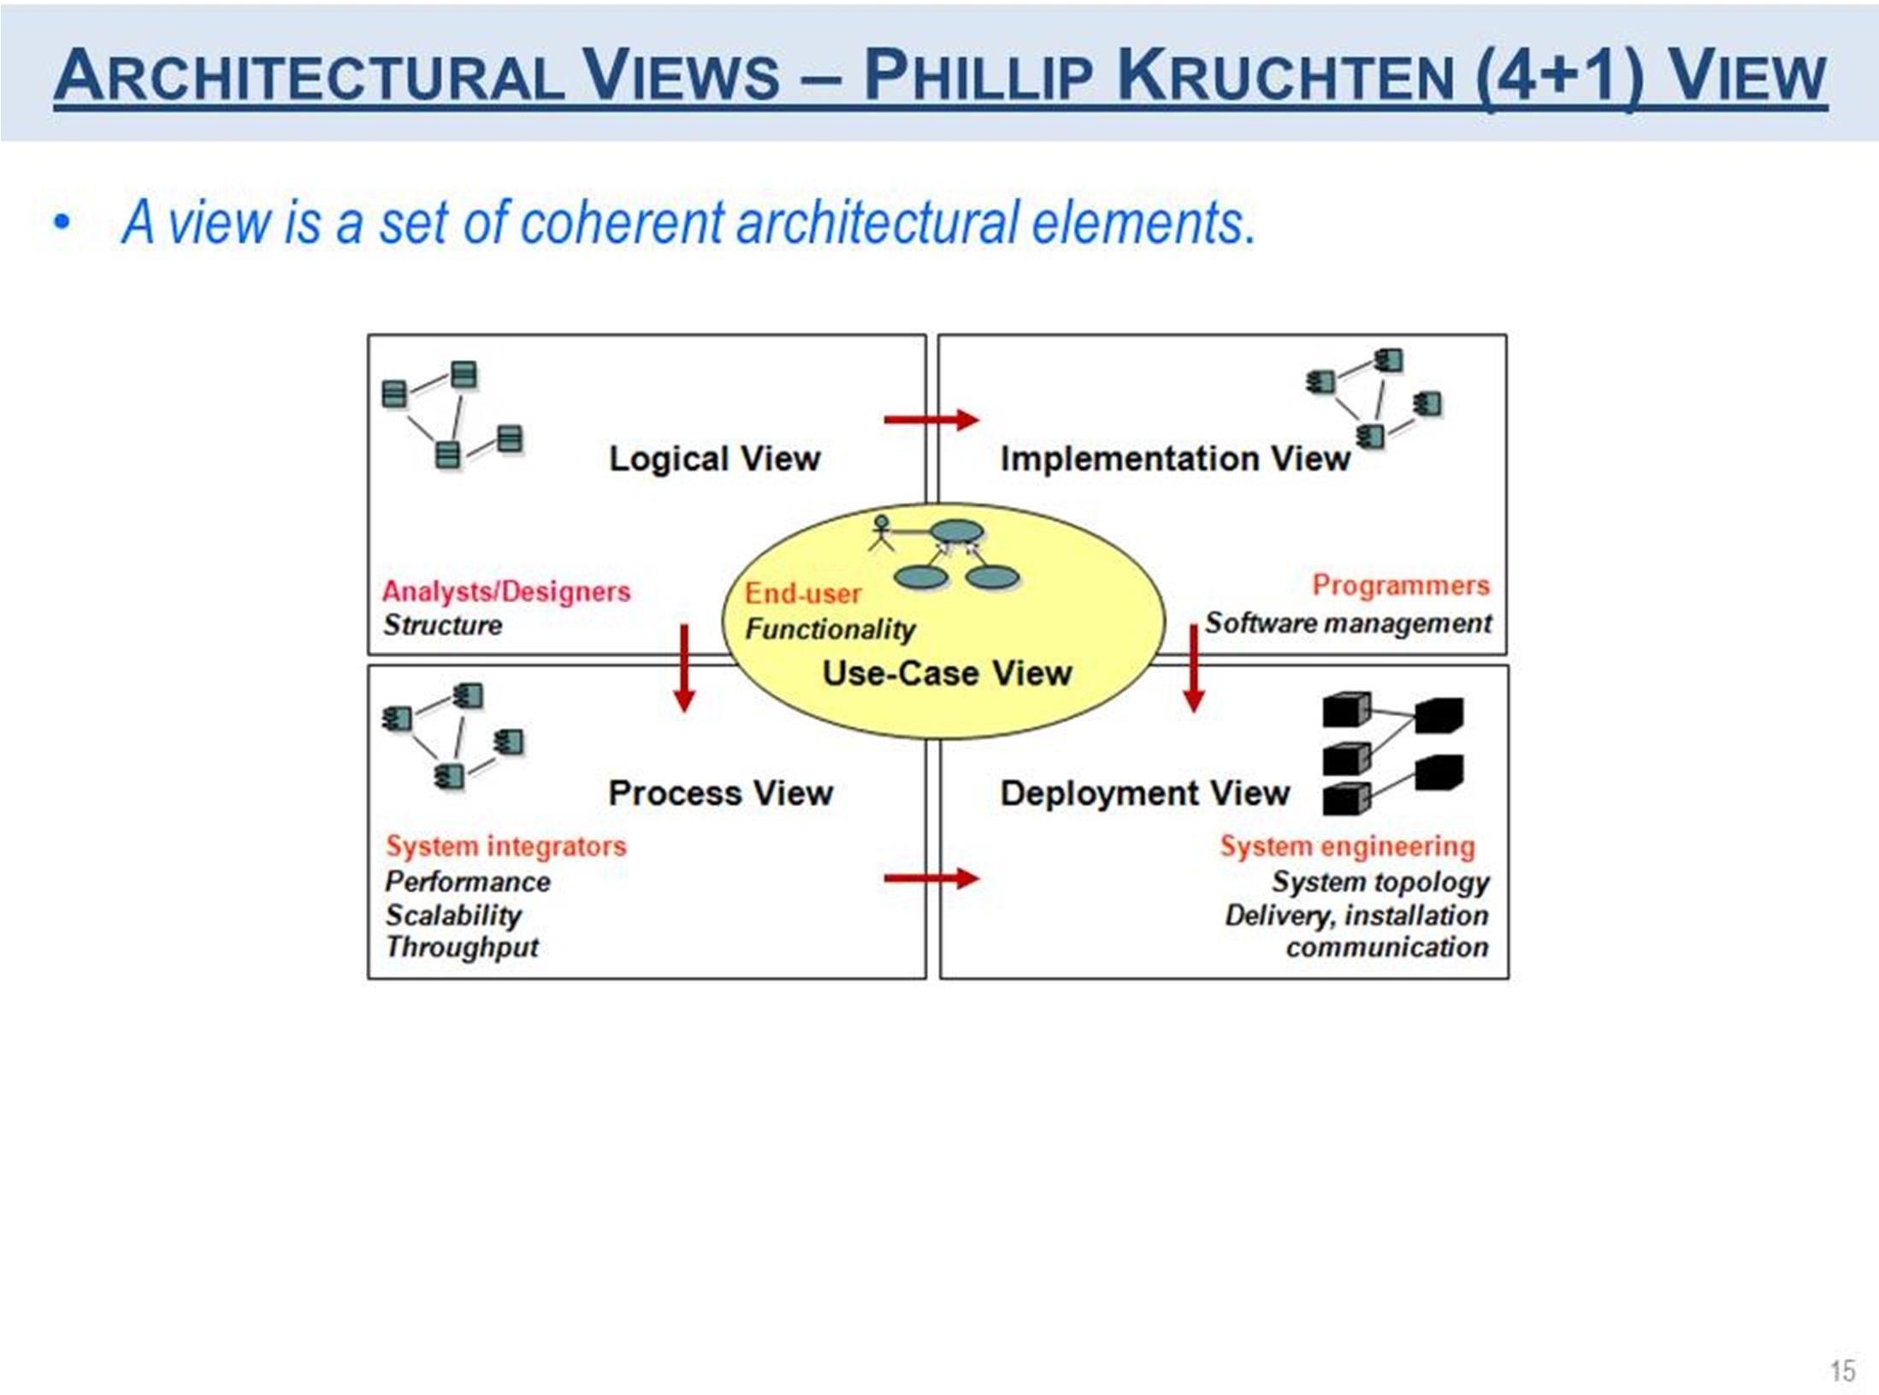

Slide 17
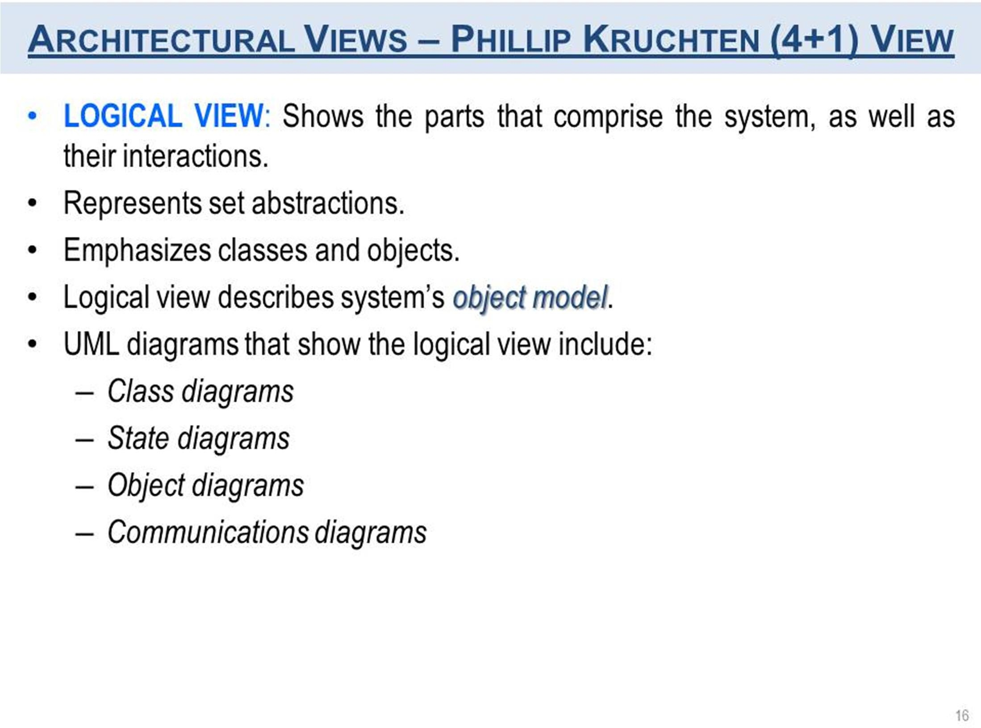

Slide 18
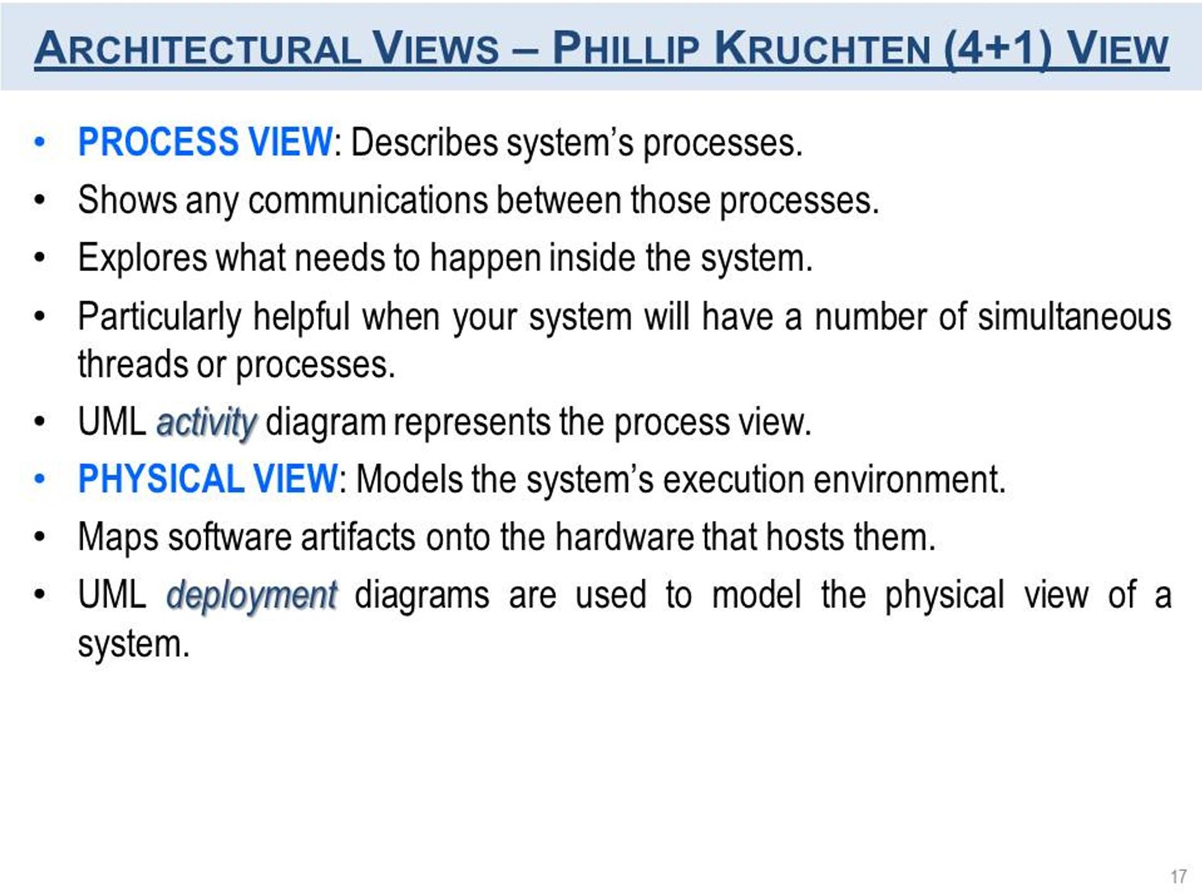

Slide 19
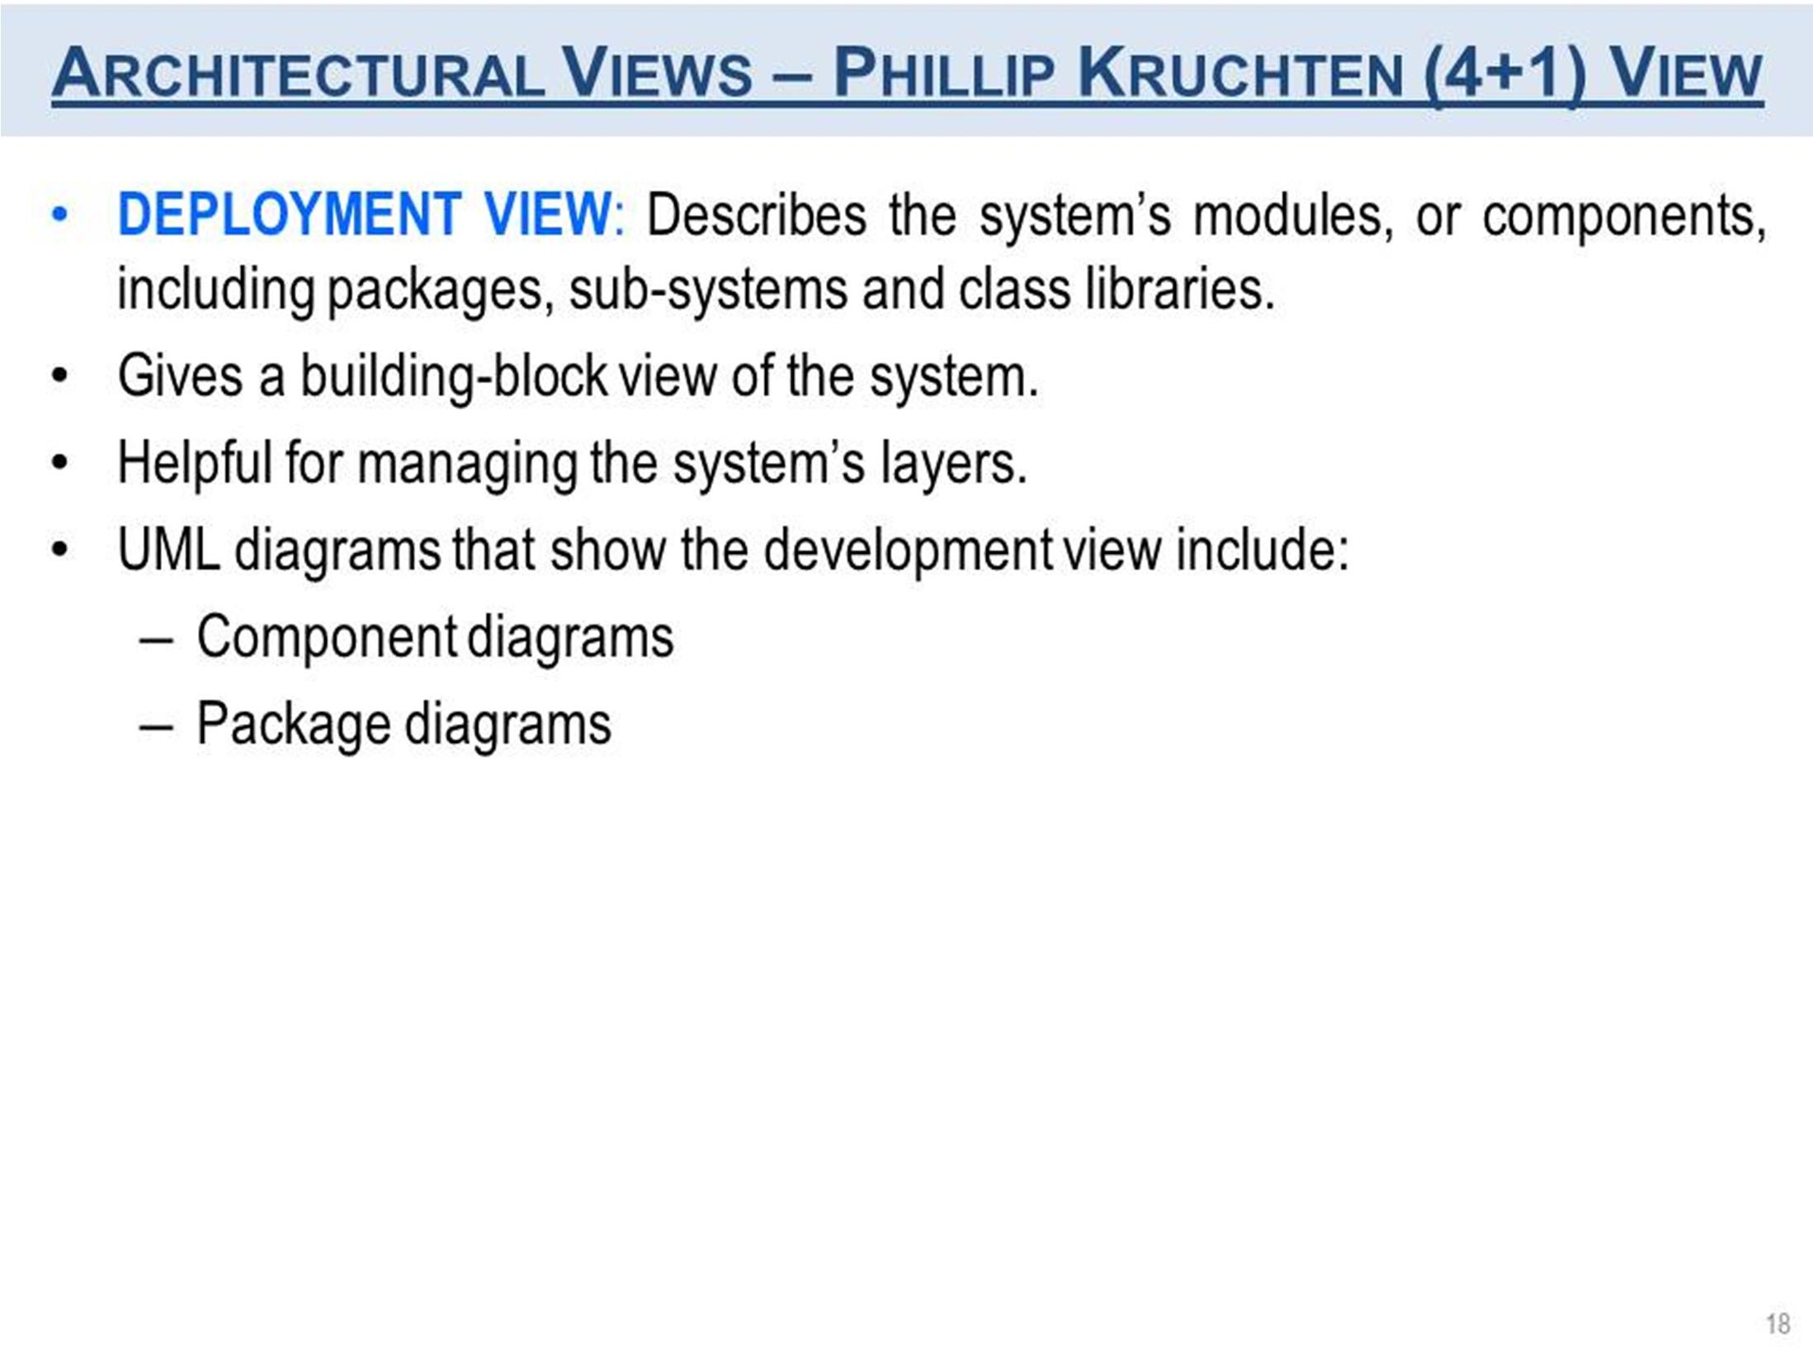

Slide 20
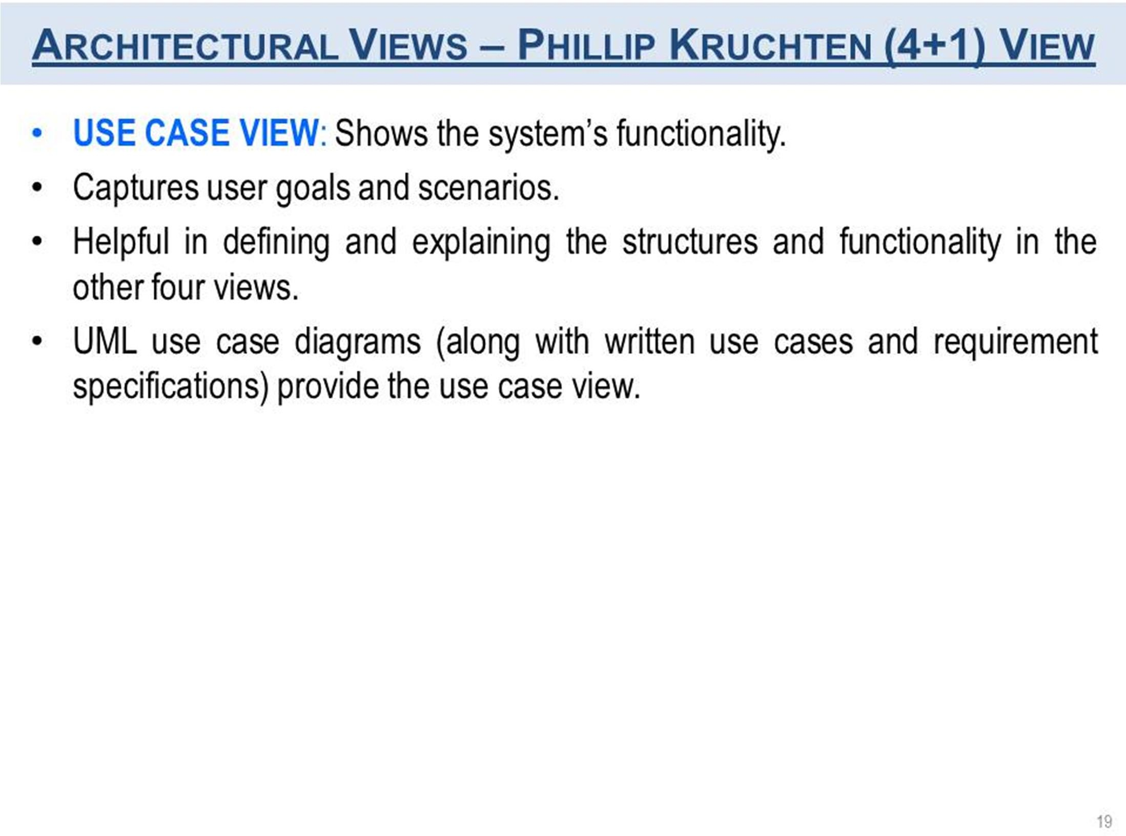

Slide 21
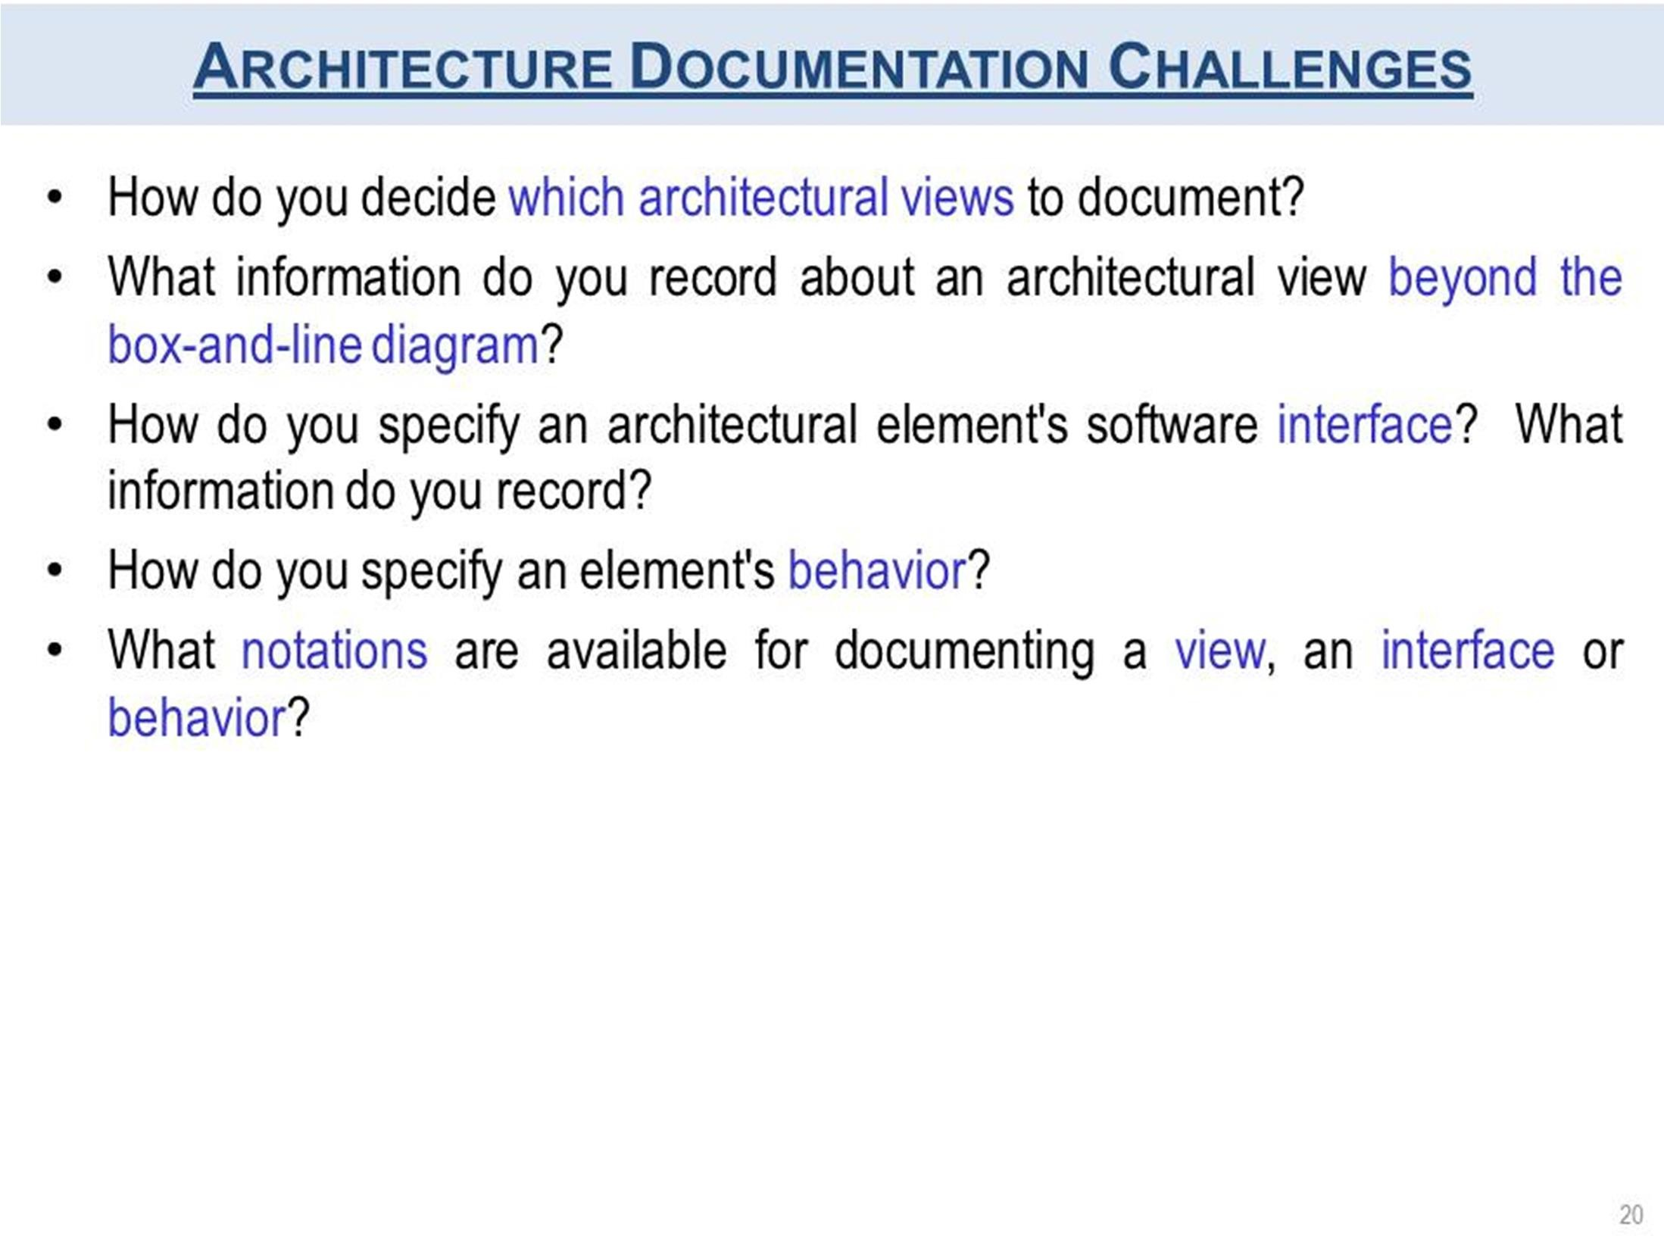

Slide 22
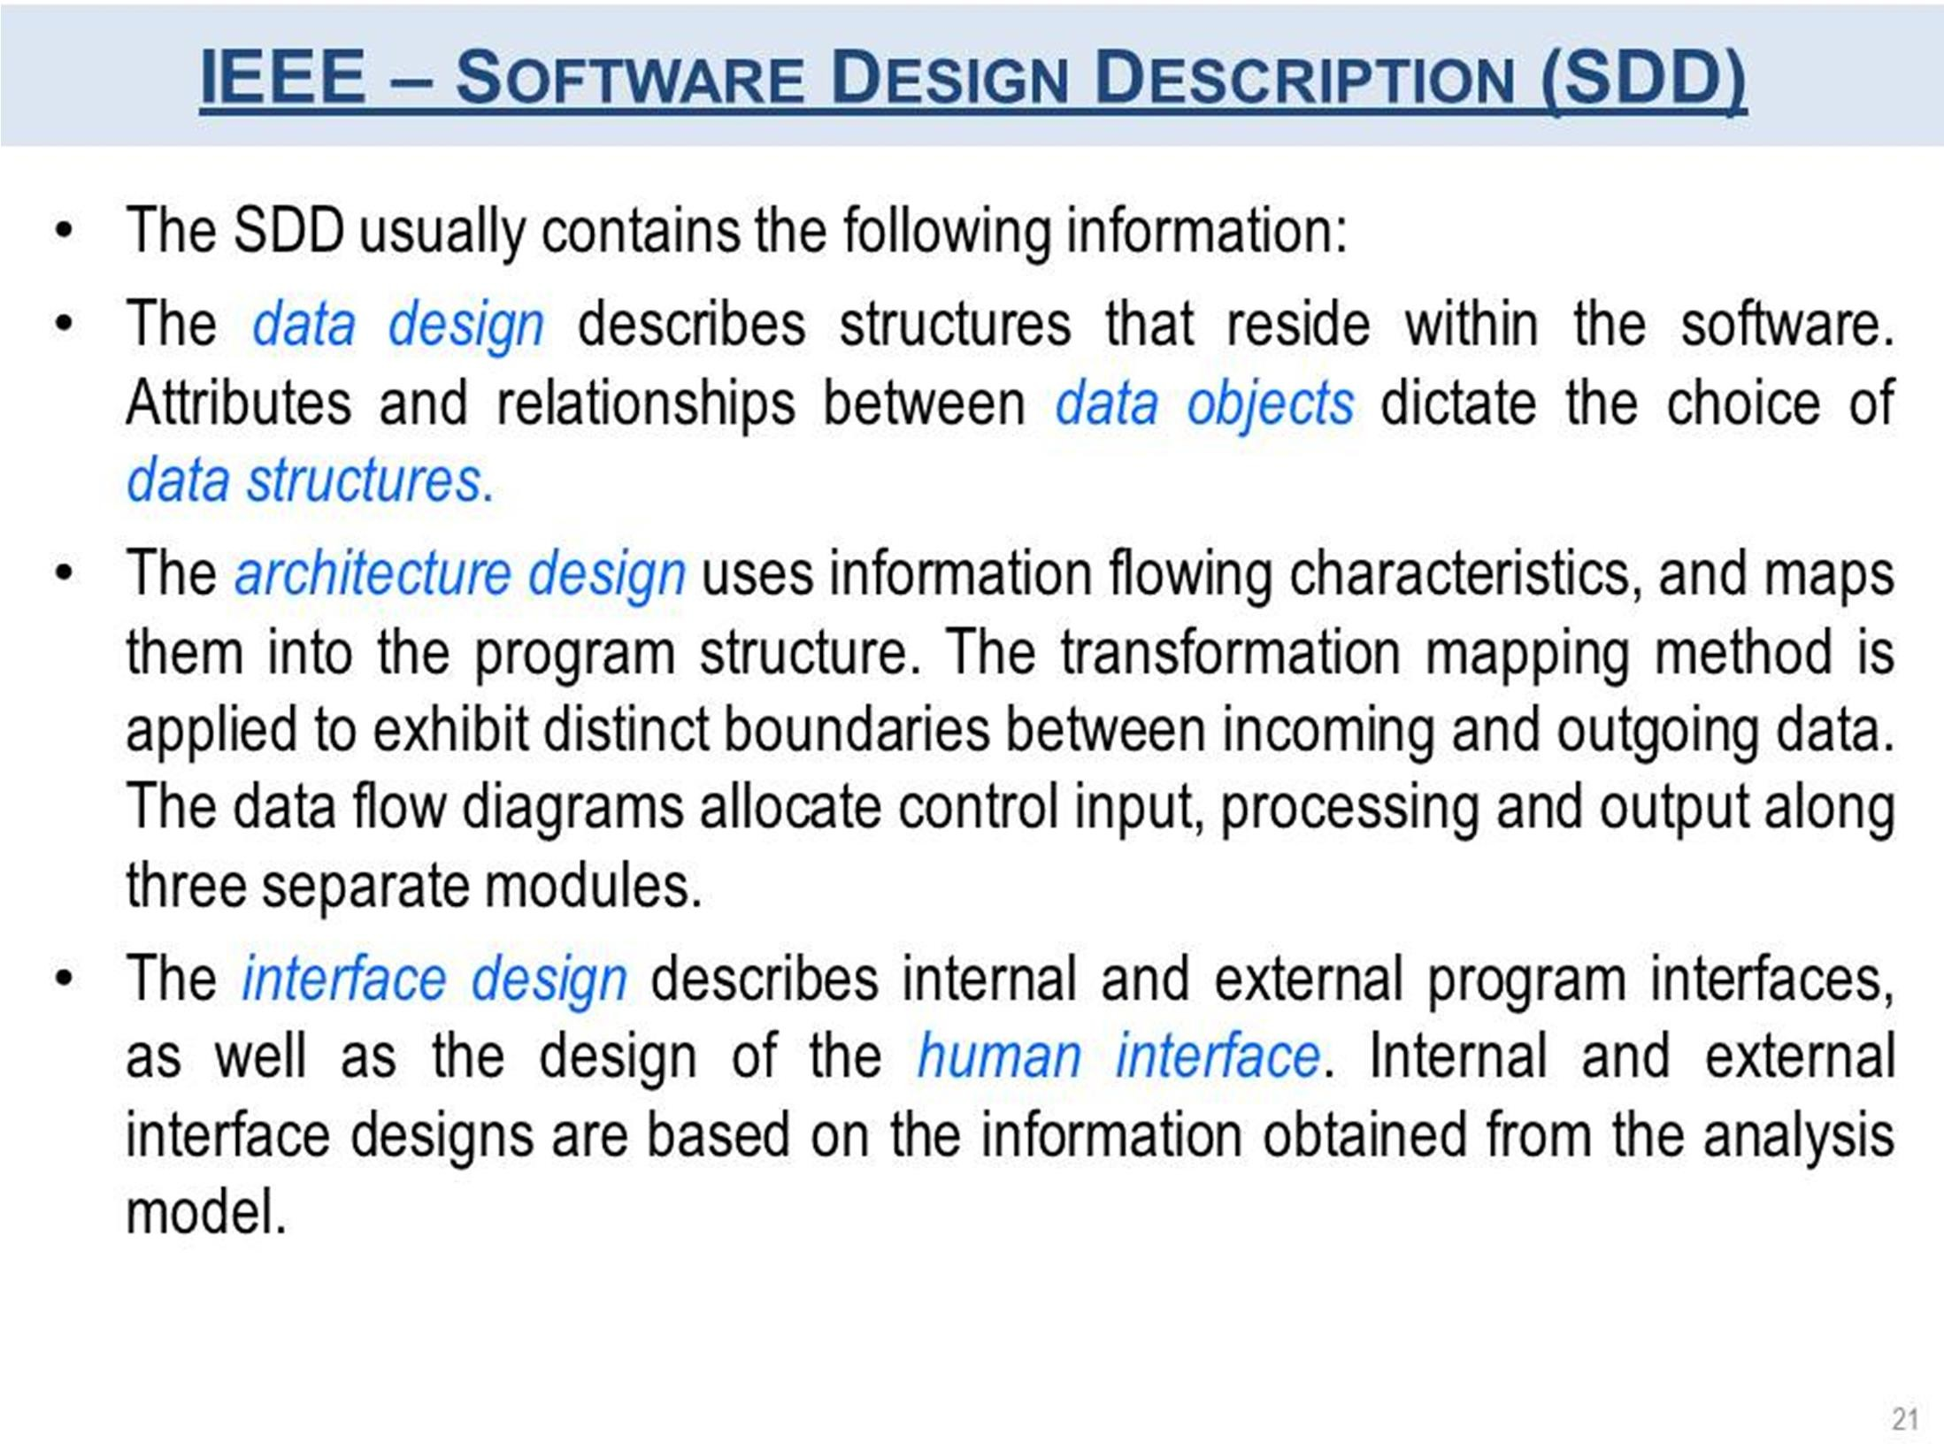

Slide 23
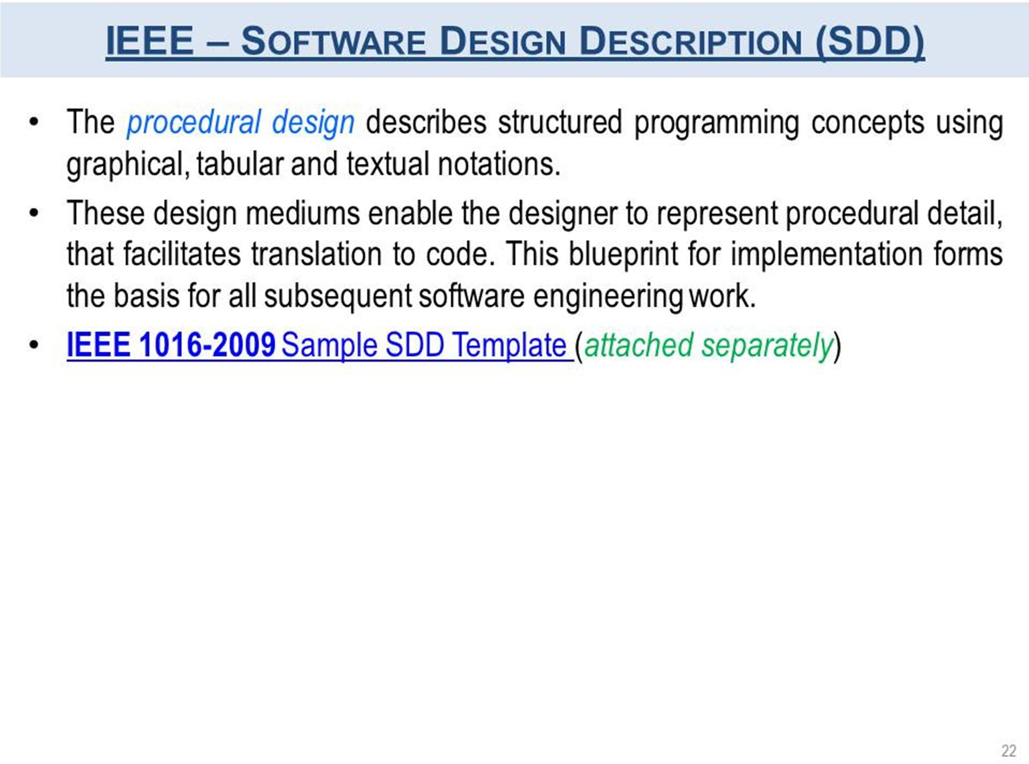

Slide 24
Continue….
Any thing to ask ??

